Slide 1
Jolly Toddler’s Presents:
Green Cleaning, Sanitizing, and Disinfecting

Slide 2
Purpose
Regular cleaning is important for maintaining a healthy environment.
Small children are particularly vulnerable from exposure to chemicals in cleaning products because of their size, development, and behaviors.

Slide 3
Overview
Differences between cleaning, sanitizing, and disinfecting and when and where each is needed.
The health and environmental hazards associated with using and misusing cleaning, sanitizing, and disinfecting products.
How to choose safer cleaning, sanitizing, and disinfecting products.
Proper cleaning, sanitizing, and disinfecting techniques

Slide 4
Intro- Why are Children more susceptible to germs?
They breathe 4-6 times more air than adults and they breathe close to the ground where pollutants in the air tend to concentrate.
They have more skin covering their bodies relative to their weight than adults.
They have more skin contact with the floor because of their size and behavior. This means they can absorb more pollutants that concentrate on the floor through their skin.

Slide 5
Intro Cont’d- Why are Children more susceptible to germs?
They eat more food per pound of baby weight than adults. They are also more vulnerable to food borne illnesses.
Their hand-to-mouth behavior means they eat more dust than adults. Dust contains many toxic chemicals from cleaning products, pesticides, and other sources.
Mouthing objects is more common in young children.

Slide 6
Intro Summary
Young children are still developing and have immature bodies. Their bodies are less able to get rid of toxic substances than adults. Their developing organs—especially their brains—can be affected by exposure to toxic substances. This can affect their growth and their ability to learn and function.

Slide 7
Copy & paste the following for a video on
the effects of toxins on developing children
https://youtu.be/KznQn6nVfZc

Slide 8
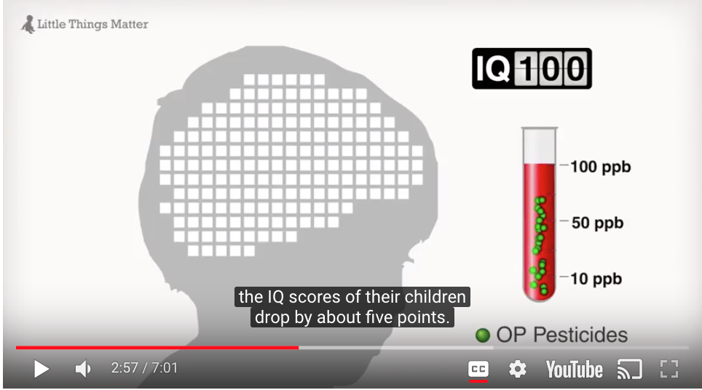
As the body burden of PBDEs in pregnant women increases, the intellectual ability of their children decreases.
The impact of toxins on the developing brain is permanent. Children who are more heavily exposed to toxins won’t reach the same peak cognitive ability as those who have lower exposures.

Slide 9
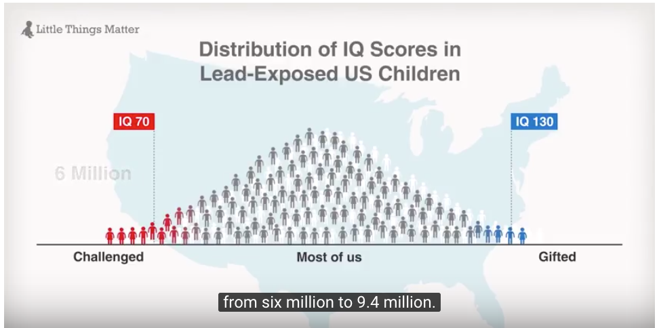
Most of us have IQs 85 or above. Those with 130 and above are considered GIFTED. Those with an IQ below 70 are considered CHALLENGED. Exposure to PBDEs will result in a 5% shift from 6 million to 9.4 million children who are considered CHALLENGED. It will also result in less children being GIFTED. Little shifts matter…

Slide 10
European Union
Requires testing before products that are packed with harmful chemicals are released into the environment. US and Canada have not followed suit. It’s something we may want to consider. Are we using our children unwittingly in this “experiment”?

Slide 11
Common Triggers
Respiratory illnesses like colds, flues, and asthma are the most common reason children are absent from ECE. Cleaning removes allergens and irritants that can cause or trigger asthma.
The presence of moisture, standing water, and mold can cause respiratory problems.
Organized, uncluttered areas are the easiest to clean.

Slide 12
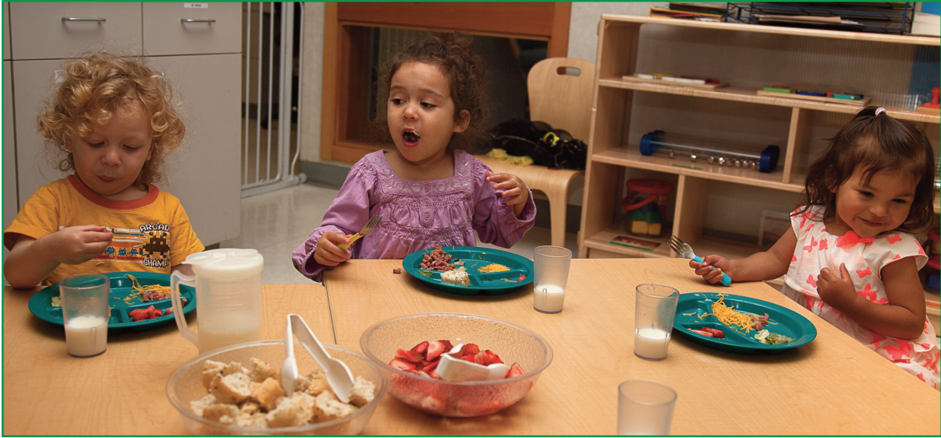
Why Green Cleaning?
Most of us are under the impression that the EPA or US Environmental Protection Agency considers ALL health risks posed by products available to the public.
IT’S JUST NOT TRUE.

Slide 13
Children are more sensitive to health effects
Fetuses & very young children are particularly sensitive to the effects of toxic chemicals. During early development, growth is rapid and organs—especially the brain—are developing.
Researchers estimate 5% of childhood cancer and 30% of childhood asthma are related to chemical exposure.
Effects may not show up for years, even decades.

Slide 14
TEN REASONS TO GO GREEN
Reduces germs, allergens, toxic chemicals & pests
Manufacturer of cleaning products do not have to list product ingredients on the label.
Chemicals washed down drain where they can end up in drinking water, streams, lakes, etc. hurting people, animals, and threatening public health.
Certified green products avoid fragrances and scents
Harmful chemicals affect unborn babies & young children more than adults.
Bleach is not a certified green product!

Slide 15
TEN REASONS TO GO GREEN
Certified green products do not contain triclosan, which is in some antibacterial soaps.
Newer, safer products exist.
Using safe products protects health of custodial staff.
Parents want the best for their children!

Slide 16
REMEMBER!
There is no legal definition of the term “green” as applied to cleaning products so products with this term will make the public think they’re safer, but the reality is, there’s no assurance.

Slide 17
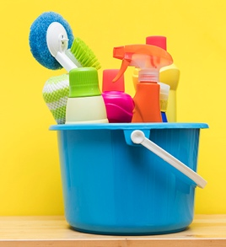
Poisons
Every year, 6 out of 100 professional custodians are injured by chemicals they use to clean.
Burns to eyes and skin are the most common, followed by breathing in toxic chemicals.

Slide 18
Common Chemicals
Ammonia/Bleach→ triggers asthma
Quaternary Ammonium Compounds (QUATs)→ Spray that causes nose, throat and skin irritation
Terpenes→ chemicals found in pine, lemon, and orange oils. It can form formaldehyde which causes cancer.
Triclosan→ suspected endocrine disruptor and may lead to the development of antibiotic-resistant bacteria
Phthalates→ chemicals used as solvents and carriers for fragrances. Increase risk of allergies.

Slide 19
Notes:
VOCs→ Volatile organic compounds that vaporize at room temp. These gases come from liquids like aerosol. Linked to asthma, allergies, and headaches. Some is made with formaldehyde, which is known to cause cancers.
Particulate Matter (PM) PM is made of particles that are small enough to be carried by the air and can be breathed in by people. Smallest particles are the biggest threat bc travels to the lungs and can pass into blood.

Slide 20
Indoor Air Pollutants
Indoor Air Quality (IAQ) is a measure of the temperature, humidity, ventilation, and chemical or biological contaminates of the air inside the building. It’s influenced by:
Ventilation system
Can windows open?
Mold in the building
Cleaning & Art supplies
Chemicals created by activities inside the building
Building material and furniture that produce pollutants like formaldehyde.

Slide 21
Indoor Air Pollutants
Sometimes air inside can be 2-5 times worse than outdoors. Sometimes that number reaches 100 times worse.
We spend approx. 22 hours a day inside.
Notes:
What are some indoor air pollutants?
-Smoking, mold, cleaning supplies, wood burning, cooktop stoves, pet dander, etc.
What do they cause?
Dry eyes, nasal congestion, nausea, fatigue, headaches, asthma, long-term health issues like asthma and cancer or heart disease believe it or not!

Slide 22
Ventilation
IAQ problems are often causes by poor ventilation.
Ventilation is when “clean” air usually from outside is brought indoors and pollutants are removed or reduced.
Ventilation occurs by opening windows and doors, or mechanically through heating/cooling/vent equipment.
Be sure open windows are screened and in proper condition.

Slide 23
Fragrances
Can contain up to 3,000 separate ingredients.
No requirement that chemicals be listed on label.
Higher levels of fragrance chemicals have been linked to reproductive problems in women.

Slide 24
“Clean” isn’t a Smell
Notes:
We tend to think the air isn’t cleaned unless it smells clean. But aerosol can be super harmful. Let’s explore how we can achieve clean air with a clean smell.

Slide 26
How to Read Cleaning Labels

Slide 27
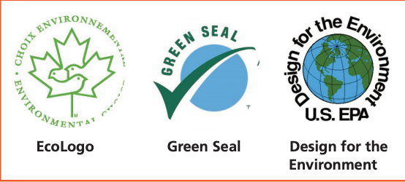
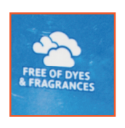
How to Read Cleaning Labels
Two Choices:
Buy products reviewed by 3rd party & certified
Or Read Label and choose product with safer ingredients
Things to Look for:

Slide 28
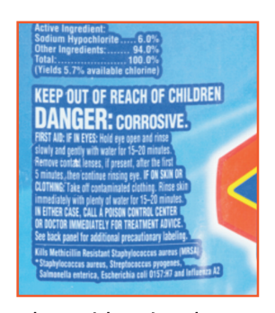
What to Look for Cont’d
Notes:
Look at the directions- what does it tell you about the product?
Look at the DANGER and WARNING- this will tell you explicitly what’s harmful about the product.
“Danger” = Highly Toxic
“Warning” =Moderately Toxic
“Caution” = Low Toxicity
No Signal word = Less Toxic

Slide 29
What is Cleaning?
It’s done with water, a cleaning product, and scrubbing.
It doesn’t kill bacteria, viruses, or fungi, generally referred to as germs. Cleaning products remove them.
Removes up to 98% of bacteria and 93% of viruses.

Slide 30
What is Sanitizing?
These products are chemicals that work by killing or deactivating germs (e.g. dishwasher, steam mop)
These chemicals are also called antimicrobial pesticides.
They are regulated in each state’s Dept. of Pesticide Regulation and the EPA.
Kills 99.9% of germs
Routine sanitizing on food areas & mouthed toys.

Slide 31
What is Disinfectant?
Kills more germs than sanitizers.
In most cases a cleaning product is used first and then the surface is sanitized or disinfected when it is necessary.
Kills 99.9% germs on hard, non-porous surfaces (e.g. carpet cannot be sanitized)
Doesn’t necessarily clean dirty surface or remove germs.
Only temporarily clean! Germs start growing immediately with a cough or sneeze!

Slide 32
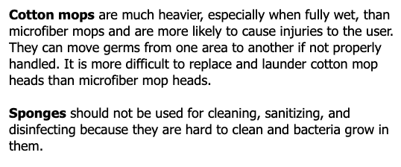
Cleaning Tools
Notes:
Microfiber is all the rage: works on multiple surfaces, last longer than cotton, durable, reusable, etc.

Slide 33
Thank you so much!
Hopefully you learned a great deal!
We have plenty of handouts and info to keep you busy if you have any further inquiries.
Thanks so much for attending and please let us know what other topics you’d be interested in learning about!

